Slide 1


CarAxia
FIND THE BEST CAR FOR YOU
By Vinay Singal
21012041056
BCA-III

Slide 2
Content
1
Project Overview
2
How it Works ?
3
Modules
4
Features
5
Snapshots

Slide 3
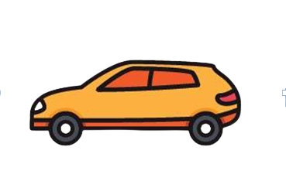
PROJECT OVERVIEW
Overview for the project – Car Rental System

Slide 4
EXISTING SYSTEM
An existing system can provide manually paper work
The user has to go in the office where user can get the car on rent and book their car.
In the existing system you can not provide feedback of the user to the admin online.

Slide 5
NEED FOR NEW SYSTEM
• The new system is totally computerized system.
• A new system provides features like time efficiency to show car details, user profiles
and whatever the customer will give the feedback to the admin.
• This system provides tourism and travelling facilities.
• An inquiry is easily done by user in the system.
• It is the most software application for managing online car rental business.

Slide 6
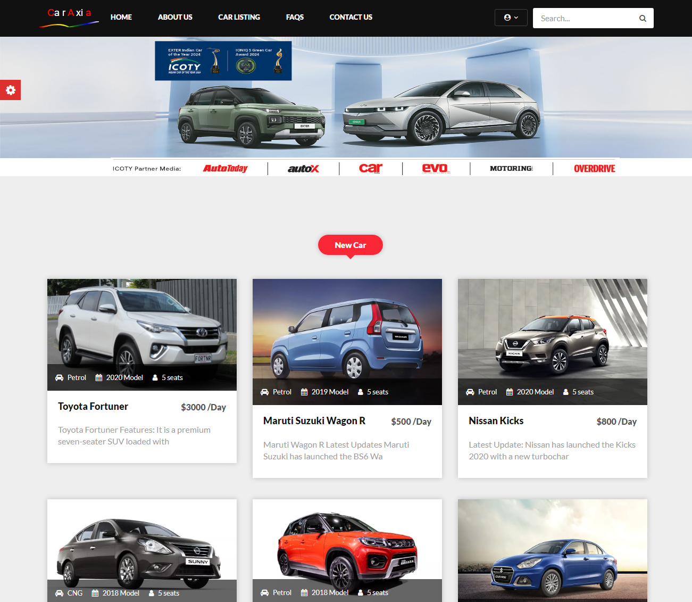
Introduction
We developed this project to book a car on rent at the fare charges. In present system all booking work done manually and it takes very hard work to maintain the information of booking and cars. If you want to find which vehicle is available for booking then it takes a lot of time. It only makes the process more difficult and harder. This aim of the project is to automate the work performed in the car rental service like generating daily bookings, records of car or cab available for booking, record of rental charges for cars for every rout, store record of the customer.

Slide 7
Hardware
Software
Requirements
Hardware
Minimum Hardware Requirements
Processor – Intel core i5/8th Gen
Hard Disk – 250 GB
Interface – basic keyboard/ Mouse
Memory – 4GB RAM
Software
Minimum Software Requirements
Scripting: HTML/CSS (front end)
Web server: Apache XAMPP
Server frame work: Bootstrap/JS
Database: My SQL/PHP (back end)
Windows 8.1 or windows 10

Slide 8
Why we need Car Rental System ?
Easy & Quick Booking
Security & Privacy
You can simply impress your audience and add a unique zing.
You can simply impress your audience and add a unique zing.
Manage your Car Rental Business
Saves Time
You can simply impress your audience and add a unique zing.
You can simply impress your audience and add a unique zing.
Access anywhere in World
Mobile Friendly System
You can simply impress your audience and add a unique zing.
You can simply impress your audience and add a unique zing.

Slide 9
HOW IT WORKS ?
Process to book a car - Car Rental System

Slide 10
How it works ?
Process to book your favorite car
Home
Login/Register
Browse Car Catalog
Book Car
Default landing page for website where visitor can login/register or view website pages.
Customers can simply login or signup for an account.
Here, customers can browse different cars and filter them according to their preference.
Finally, customers book their car and admin can review and confirm booking !

Slide 11
Home Page
Default landing page for website where visitor can login/register or view website pages.

Slide 12

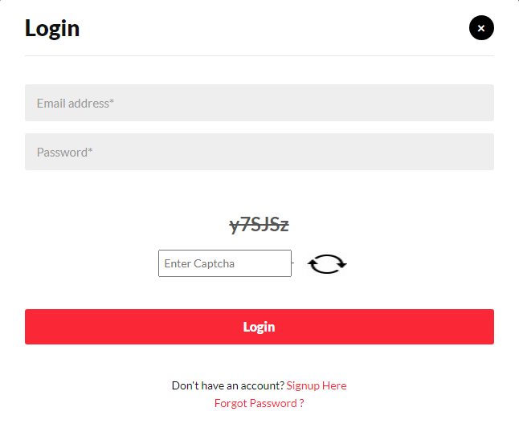
Login
Customers can simply login to an account.

Slide 13
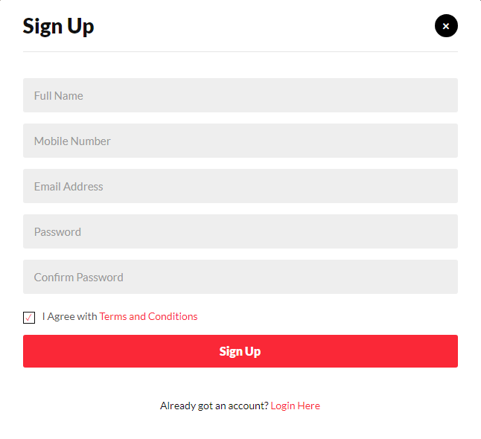
Register
Customers can simply signup for an account.

Slide 14
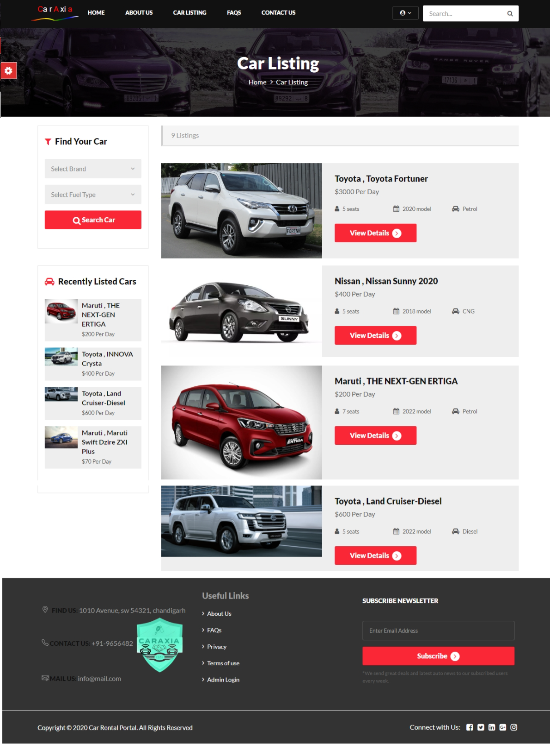
Car Listing
Here, customers can browse different cars and filter them according to their preference.

Slide 15
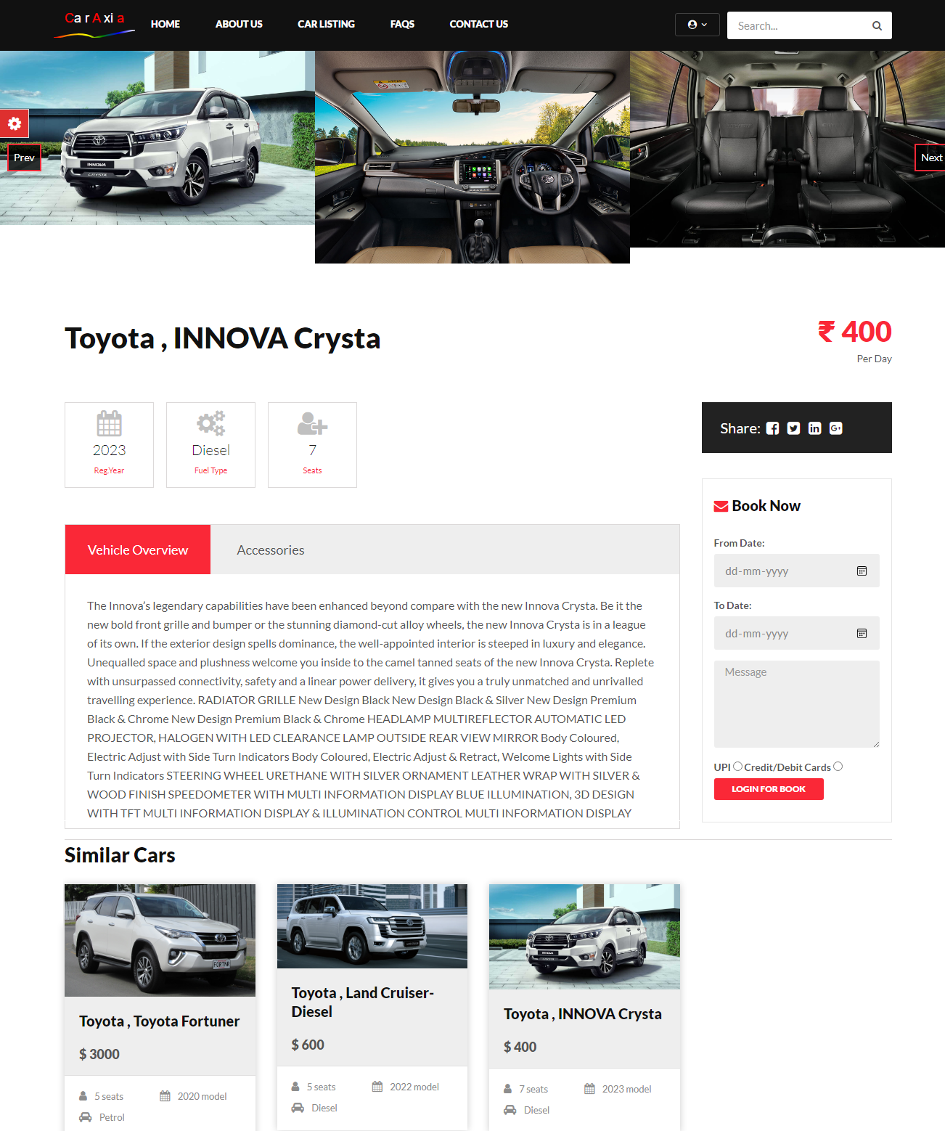
Book a Car
Finally, customers can view & book their car. Then Admin can review and Confirm Booking !

Slide 16
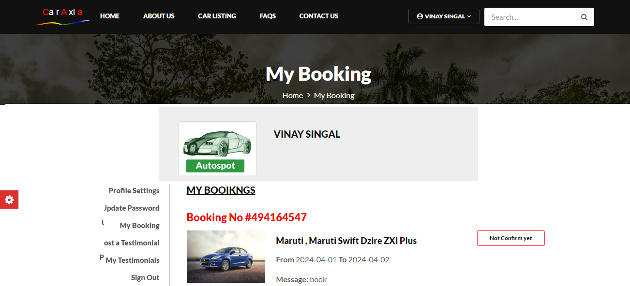
My Booking
Here customers can view all their Car Bookings and Confirmation status

Slide 17
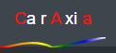
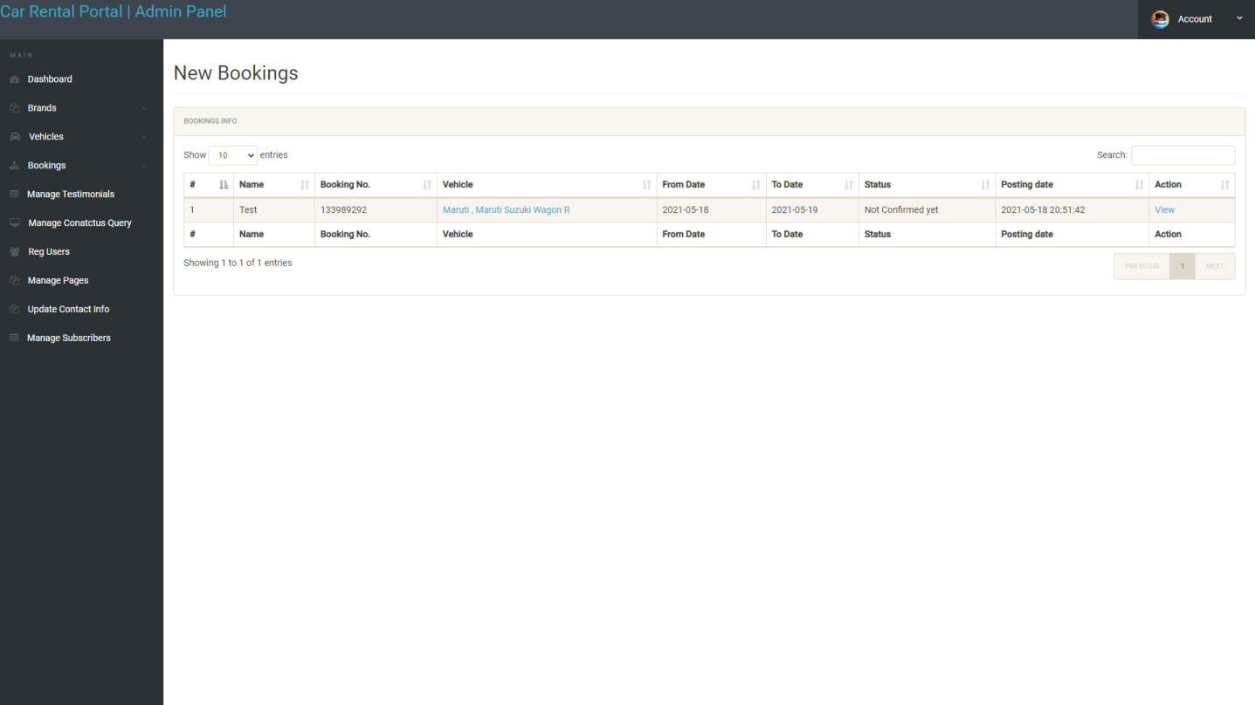

New Car Booking - Admin
Here customers can view all their Car Bookings and Confirmation status

Slide 18
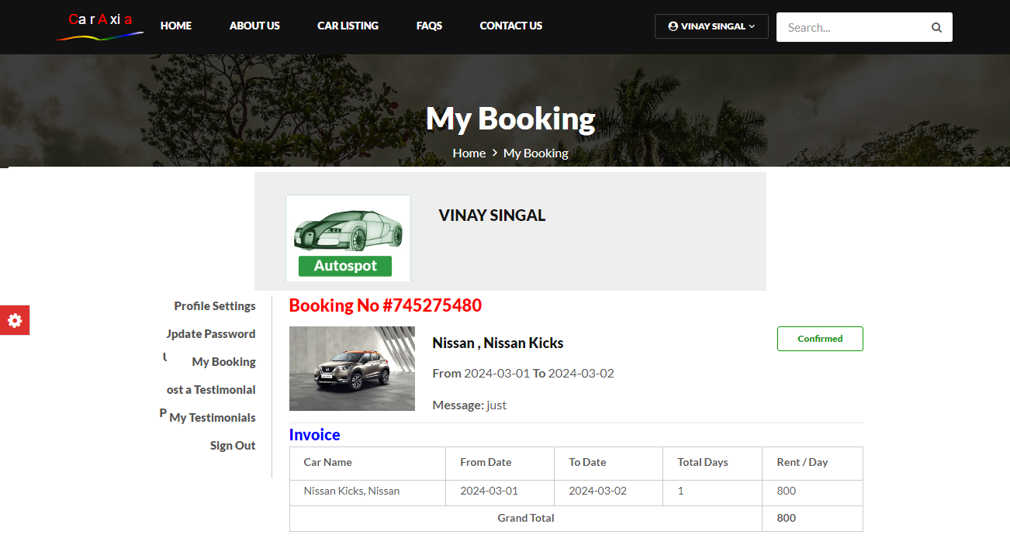
Confirm / Reject Booking - Admin
Here customers can view all their Car Bookings and Confirmation status

Slide 19
MODULES
Modules included in Car Rental System

Slide 20

Module Specification
Frontend
Customer Panel
Visitors can view, browse car catalog from Frontend. It can be accessed anywhere on a device having internet connection.
Customers can simply manage their profile, bookings, recent car booking, check status and rent a new car.
Admin Panel
Database
Admin can add a car, manage booking car and rent and also view feedback and enquiry.
MYSQL Database is used which stores and manages all data in form of tables, rows & columns.

Slide 21
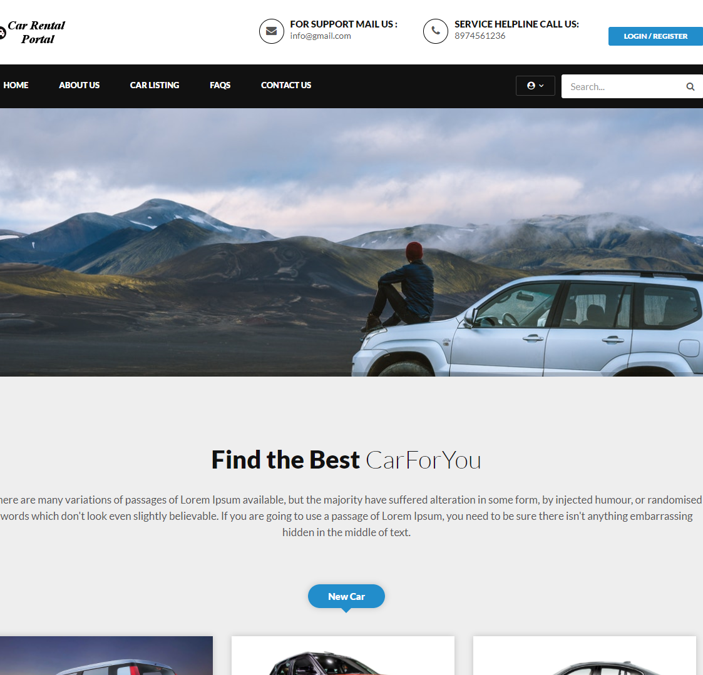
Frontend
Module
Home Page
Car Catalog
FAQs
Conatct us
Manage Cars
View Car Details
Book Car
Terms of use
Newsletter
Portfolio Presentation
Easy to change colors, photos and Text.

Slide 22
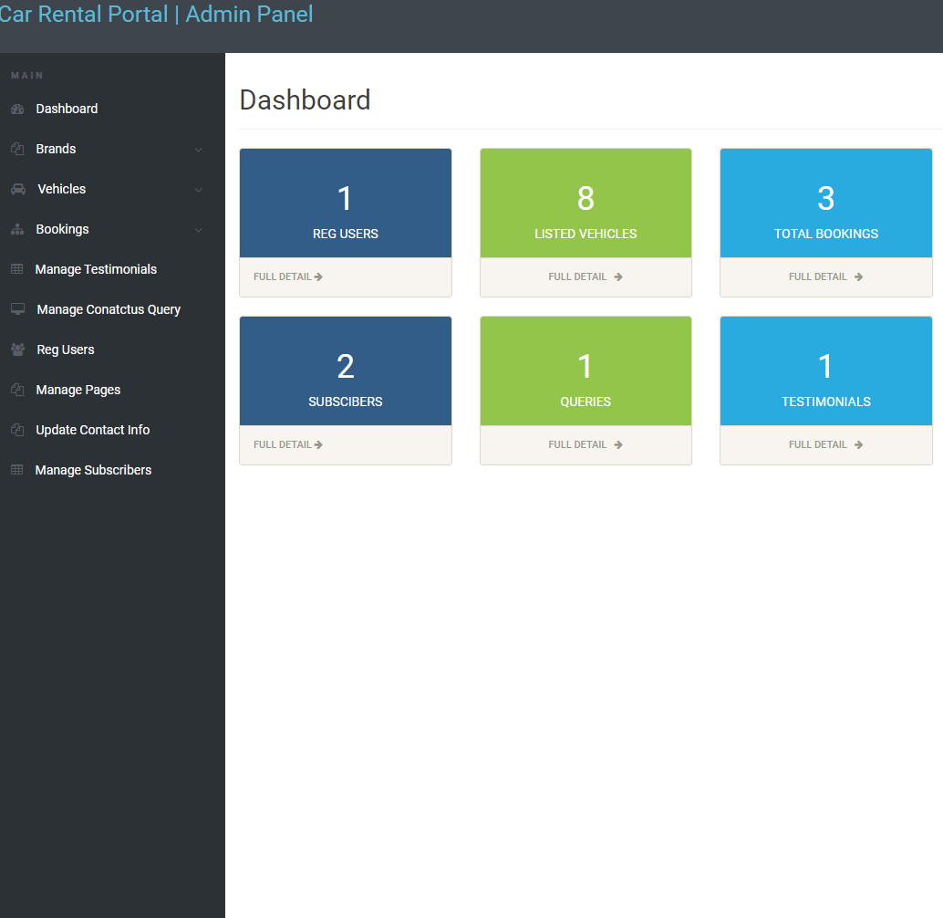
Admin
Module
Dashboard
Brands
Vehicles
Bookings
Manage Testimonials
Reg Users
Manage Pages
Update Contact Info
Manage Subscribers
Portfolio Presentation
Easy to change colors, photos and Text.

Slide 23
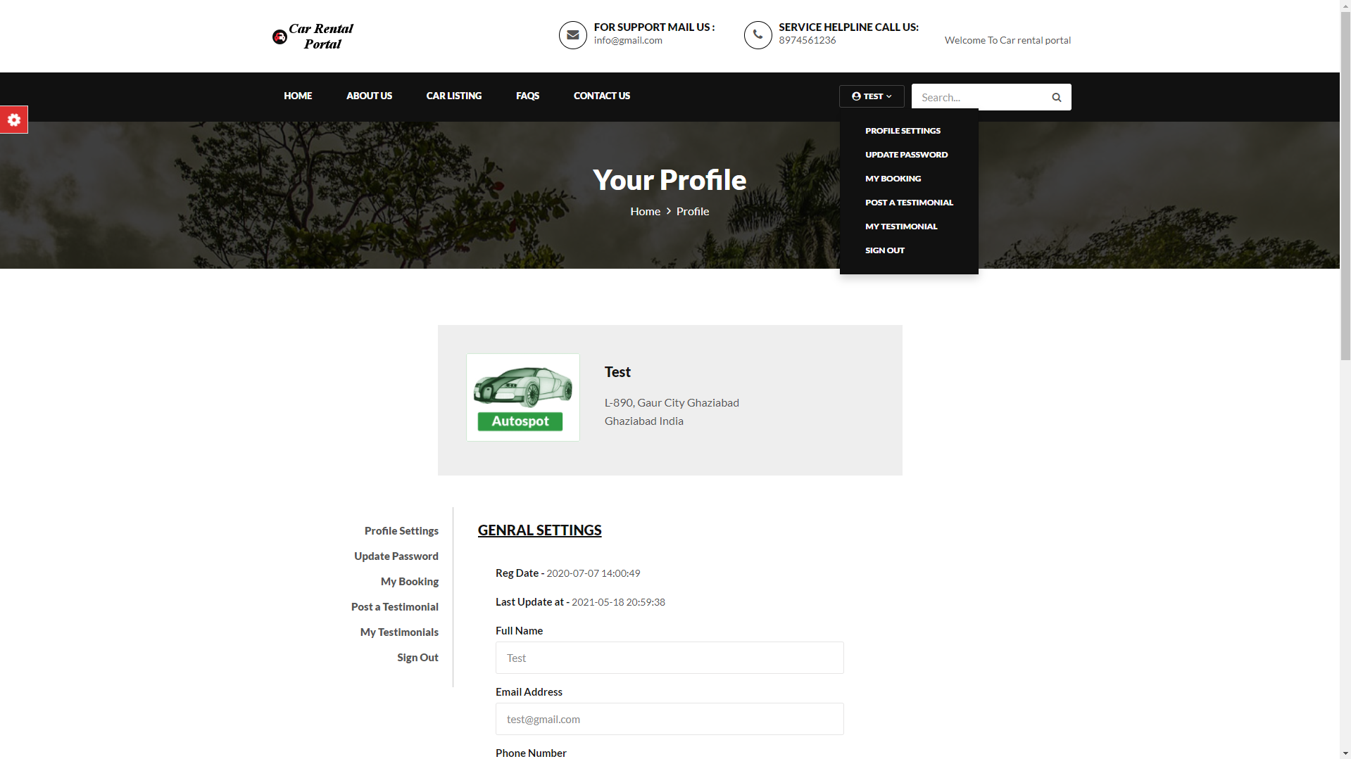

Customer Panel
Module
Profile Settings
Update Password
My Booking
Post a Testimonial
My Testimonials
Sign out
Login
Register
Reset Password

Slide 24
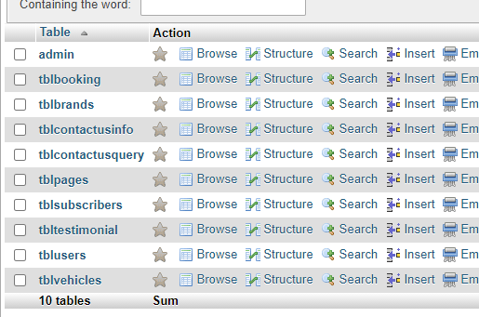
Database
Module
Database includes tables, columns & rows where we store and manage data.
For Example – In XAMPP, phpmyadmin gives us GUI to manage database easily. Screenshot of same can be viewed at right side of screen.

Slide 25
FEATURES
Features of Car Rental System

Slide 26
FEATURES OF SYSTEM
Easy Booking
Billing Invoice for Customer
Booking Confirmation
Booking interface of the system is very easy so, you can book a car easily.
Only admin can confirm your booking after your booking request.
A billing invoice will be given to the customer after booking a car or confirmed a booking.
You have to select the only time period of the booking the system calculate the rent automatically.
Saves Time
Automatic Rent Calculation
User friendly
You can save your time by using online car rental system.
The system is user friendly in use so you can easily operate the system .
Online Cancelation
Online Reviews
Mobile ready
Admin can cancel the booking on their behalf.
Customer can give review of the
system, who has experienced a service.
The system is compatible with mobile site so you can use it easily on mobile phone

Slide 27
SNAPSHOTS
Project preview screenshots

Slide 28
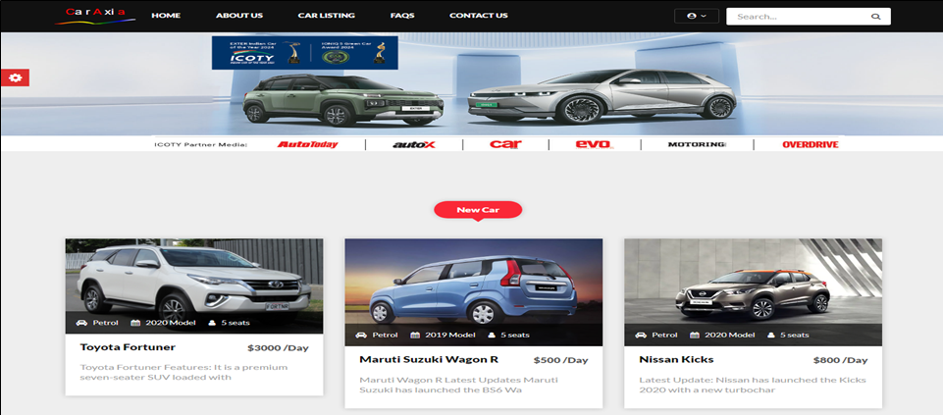
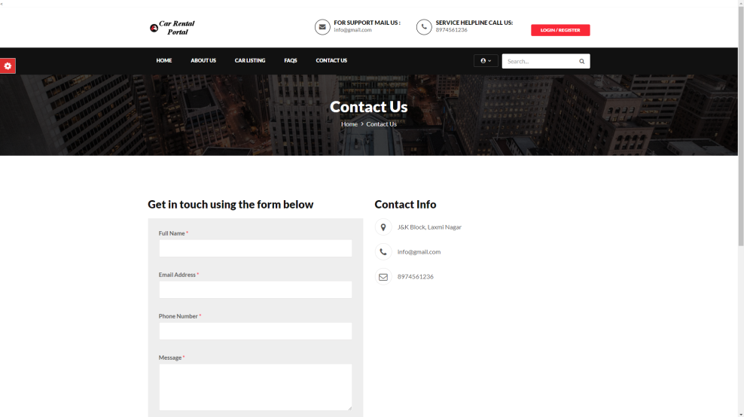
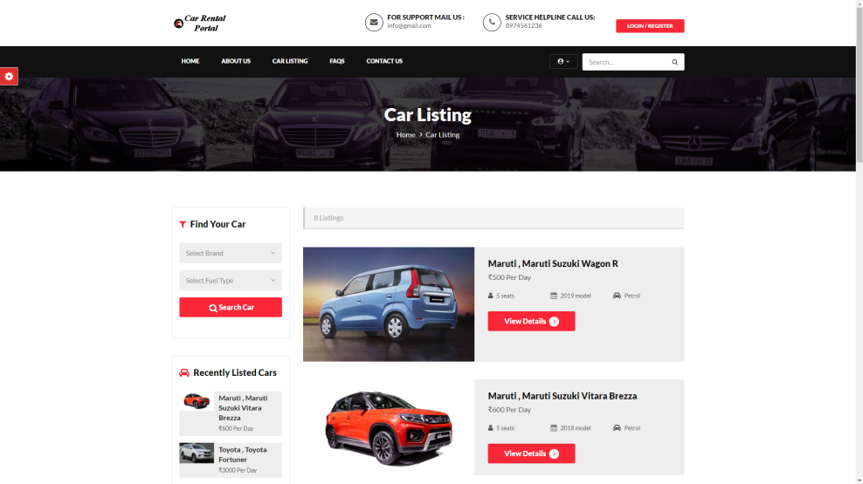
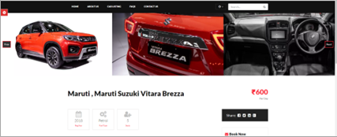
Frontend Snapshots

Slide 29
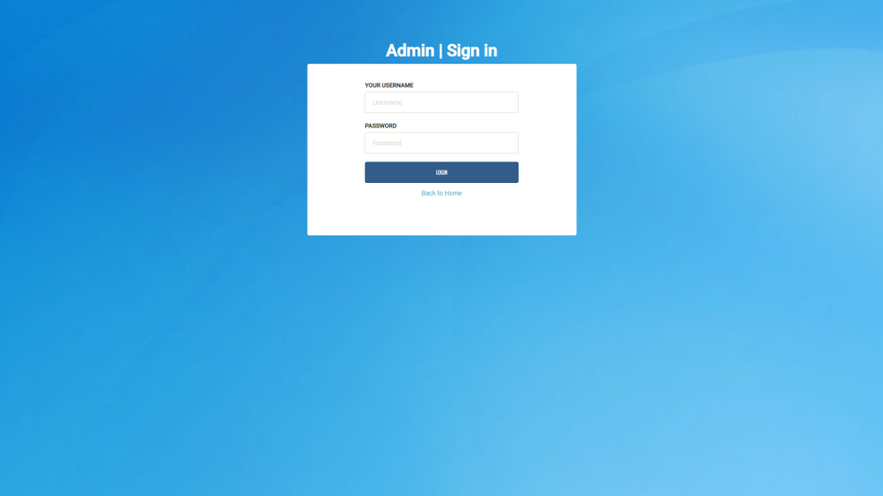
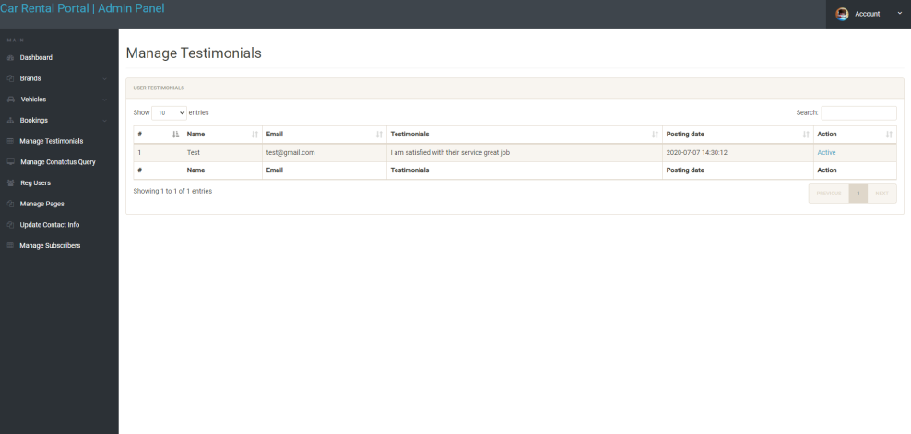
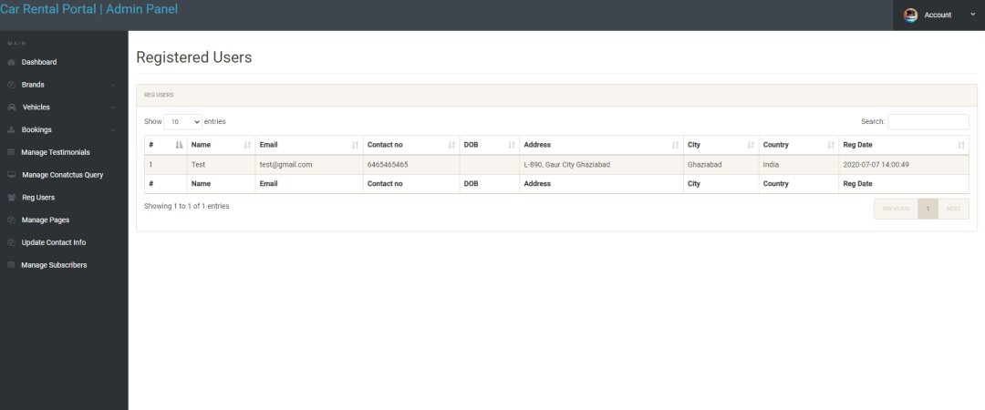
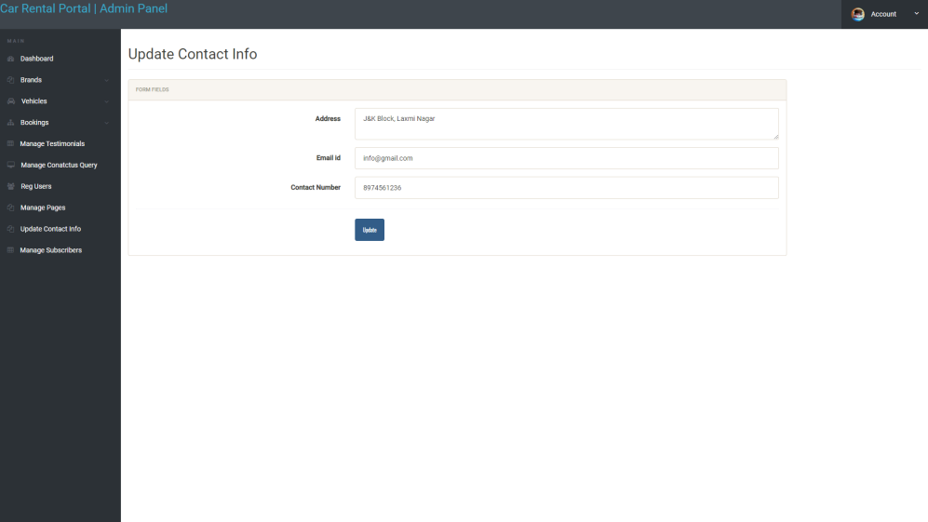
Admin Panel Snapshots

Slide 30
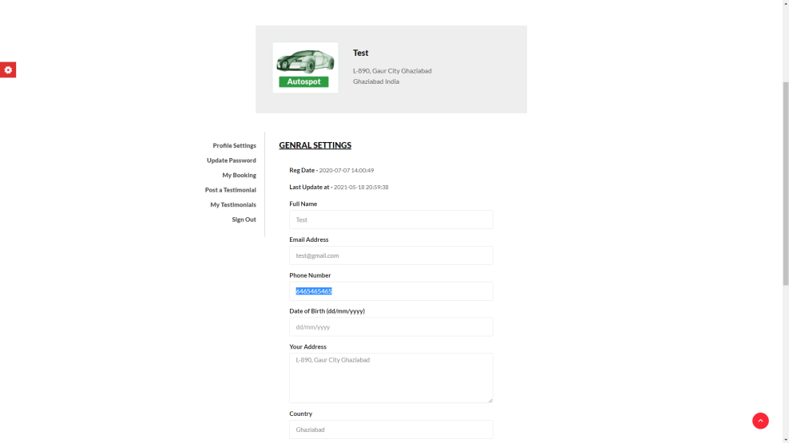
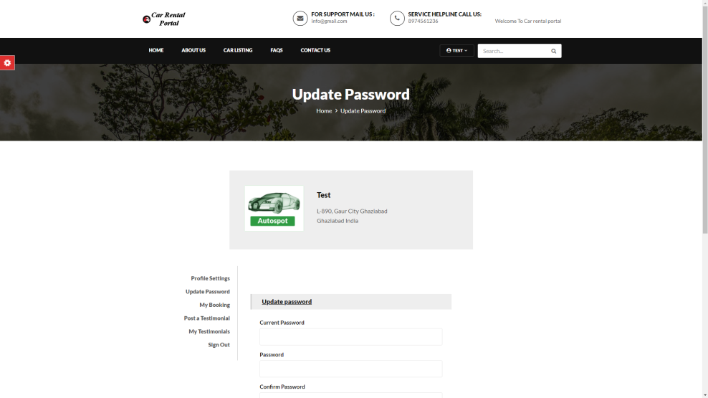
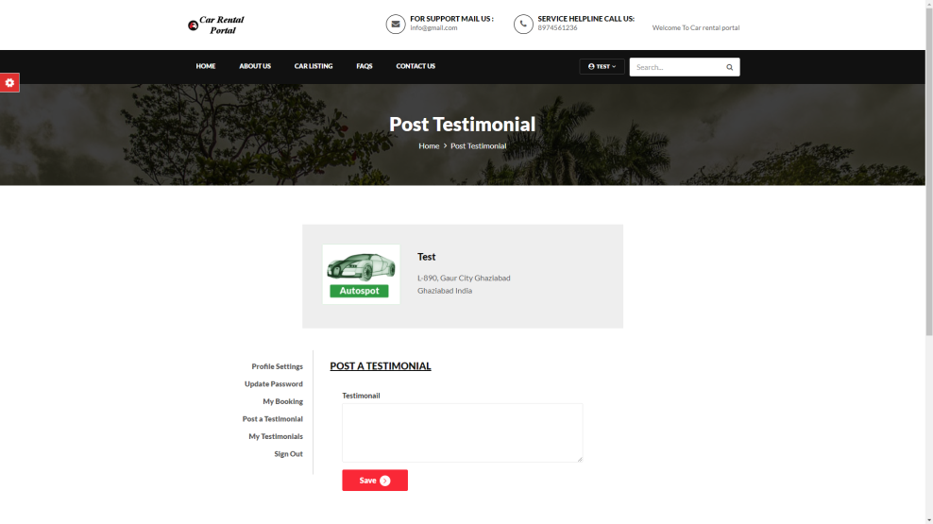
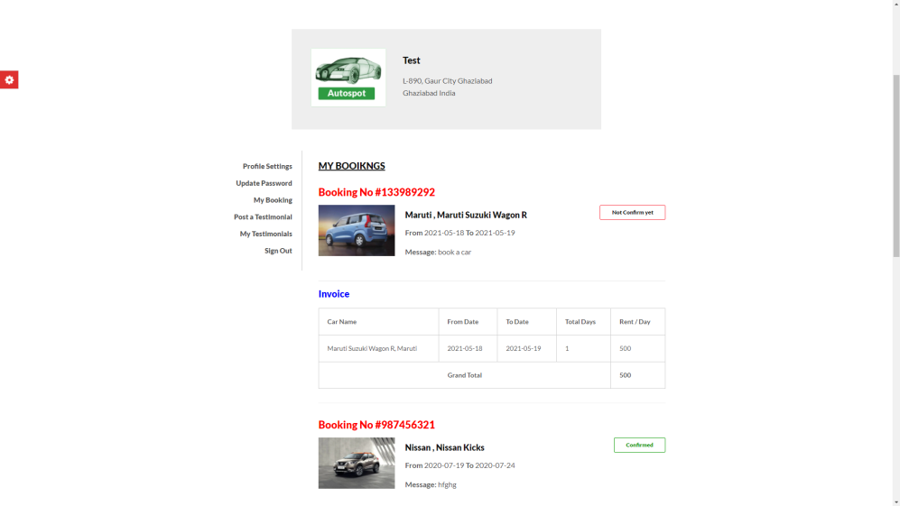
Customer Panel Snapshots

Slide 31
Thank You

